Slide 1

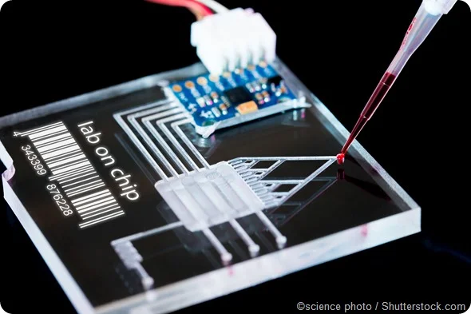

Team 78: Interdigitated Electrodes in Microfluidics
Bi-Weekly Update 1 Erin Ingram and Omar Mahmood Sponsor: Dr. Arum Han, Dr. Han Zhang TA: TBD
Notes:
Omar

Slide 2
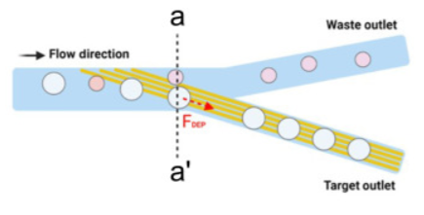
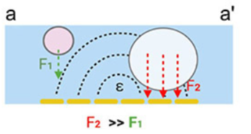
Project Summary
Mitigating satellite droplets in microfluidic “lab-on-a-chip” devices that lead to false test results
Using interdigitated electrodes to perform size-based filtration on micro fluid droplets
Notes:
Omar

Slide 3
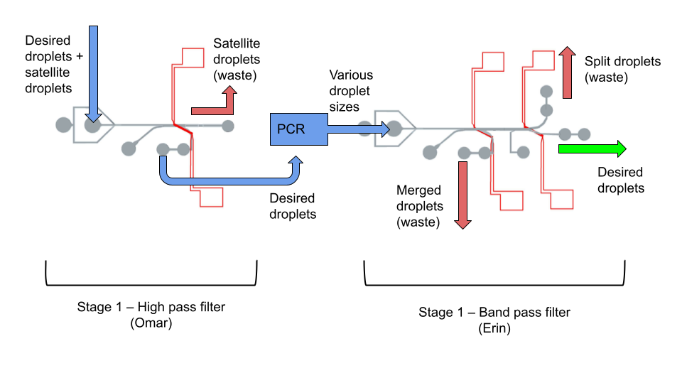
Project/Subsystem Overview
Diagram showing subsystems – with labels showing subsystem owners
Bullets giving essential system/subsystem characteristics
If major changes in subsystems, show before and after … see next slide
Notes:
both

Slide 4
Project Timeline
Fabrication
Preliminary Validation
Experiments & statistical analysis
Component Optimization
Validation of whole device
High level figure showing where you are at in the project, what’s completed, what’s underway – it should take about 30 seconds to summarize where you are in the timeline
-- Save discussion for subsystem update
-- Save detail for execution plan & validation plan status
Fabricated High Pass Filter
Fabricated Band Pass Filter
Fabricated IDE’s
No leakages or blockages
High Pass filter sorts within acceptable range
Band Pass filter sorts within acceptable range
Test different voltages
Test different IDE parameters
Use image processing software
Refabricate IDE’s if needed
Design new channels if needed
Decide on IDE parameters
Run whole system together
Test droplet maneuverability between filters
Notes:
erin

Slide 5
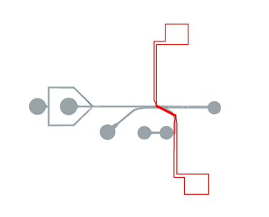
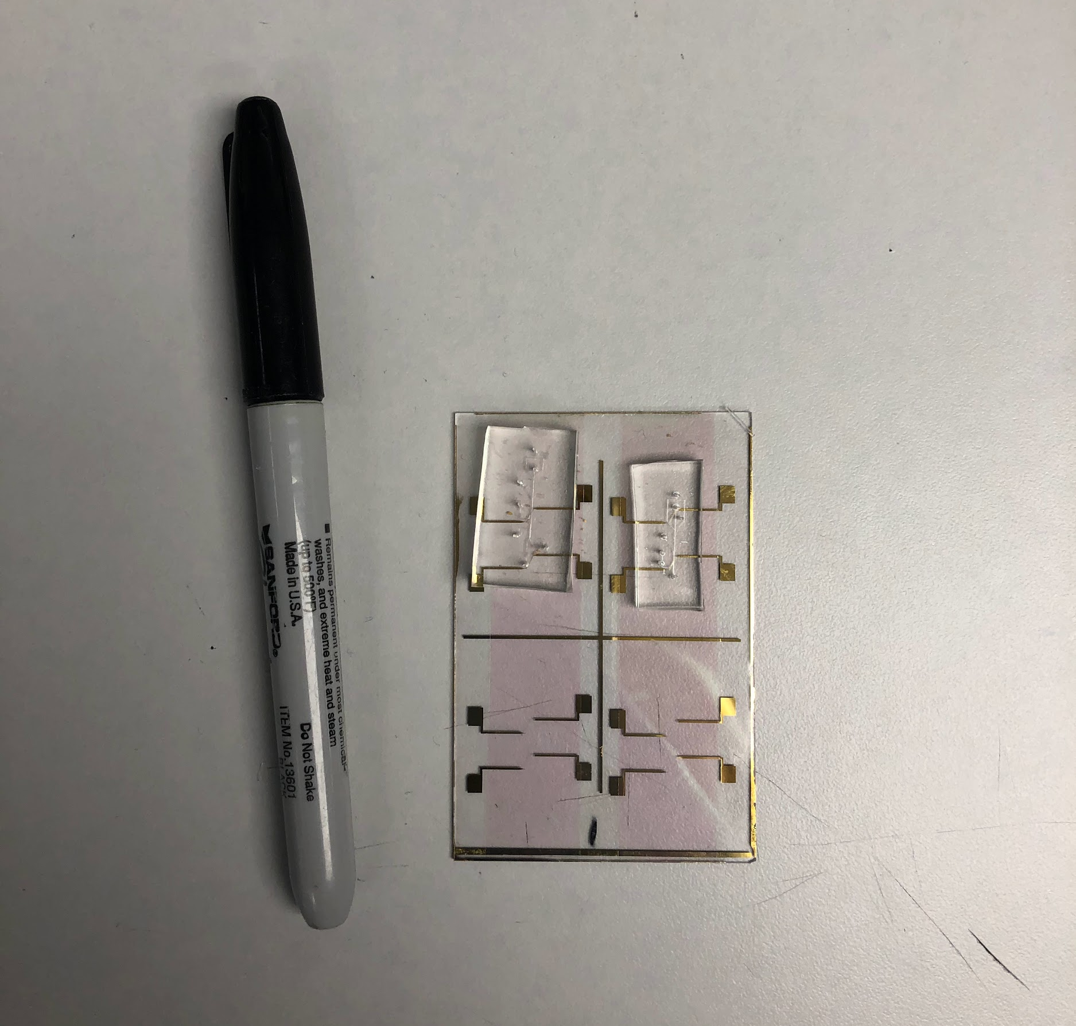
Subsystem 1: High Pass Filter
Omar
Accomplishments since 403 3 hrs of effort | Ongoing progress/problems and plans until the next presentation
Fabricated 3 channels | Further analysis using image processing software Start experimenting with different parameters Fabricate more channels
Notes:
omar

Slide 6
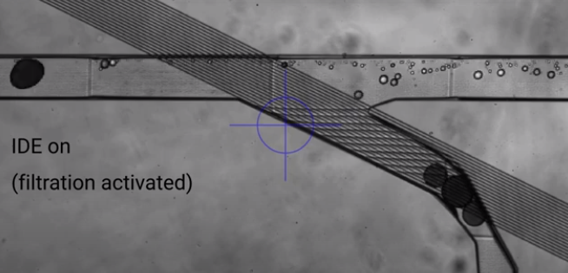
Subsystem 1: High Pass Filter
Omar
Channel should be widened for better flow
Interesting figure related to your subsystem progress
Detail on what works, what doesn’t, what is changing
Notes:
omar

Slide 7
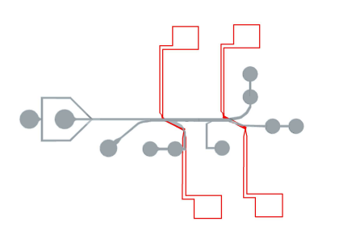
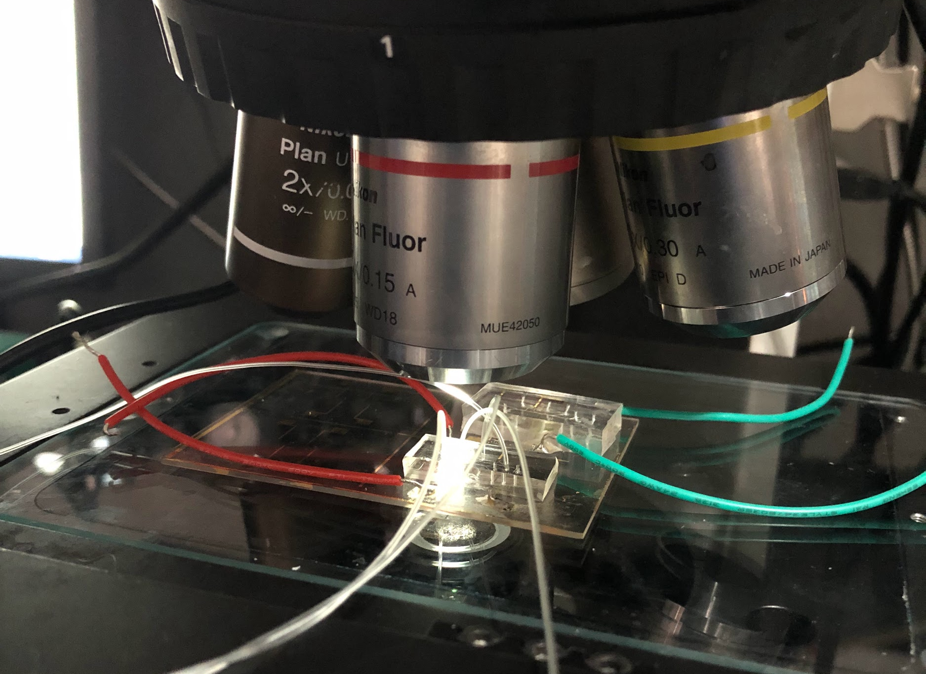
Subsystem 2: Band Pass Filter
Erin
Accomplishments since 403 3 hrs of effort | Ongoing progress/problems and plans until the next presentation
Fabricated 3 channels for experiments | Statistical analysis using image processing software, determine experimental passband Experiments
Notes:
erin

Slide 8
Subsystem 2: Band Pass Filter
Erin
Lower filtration efficiency than HPF
Oil bias balancing is more difficult → filtration efficiency suffers
To improve this, more practice with experiments / oil biasing needed
Different IDE designs / applied voltage could help with this (testing in future experiments)
Keeping same design
Notes:
erin

Slide 9
Execution & Plan
Execution plan
Your team planned milestones for completion of any remaining subsystem functionality, integration of specific subsystems, test, and validation plans should be presented.
Milestones should have owners … things like final integration can be group owned
Gantt chart – should indicate some 404 progress.
Try to complete all subsystem function in next 3 weeks.
Try to complete all integration 2 weeks before demo to allow for system validation and documentation
 | February | March | April
High Pass Filter (Omar) | Image processing/stat analysis Test Different Parameters -Voltage -IDE’s | Finalize best parameters (voltage, IDE width/distance) and conduct individual experiments | Integrate both filters together Validate
Band Pass Filter (Erin) | Image processing/stat analysis Test Different Parameters -Voltage -IDE’s | Finalize best parameters (voltage, IDE width/distance, fluid biasing) and conduct experiments | Integrate both filters together Validate
Notes:
erin

Slide 10
Thank you!
Questions?

